Slide 1
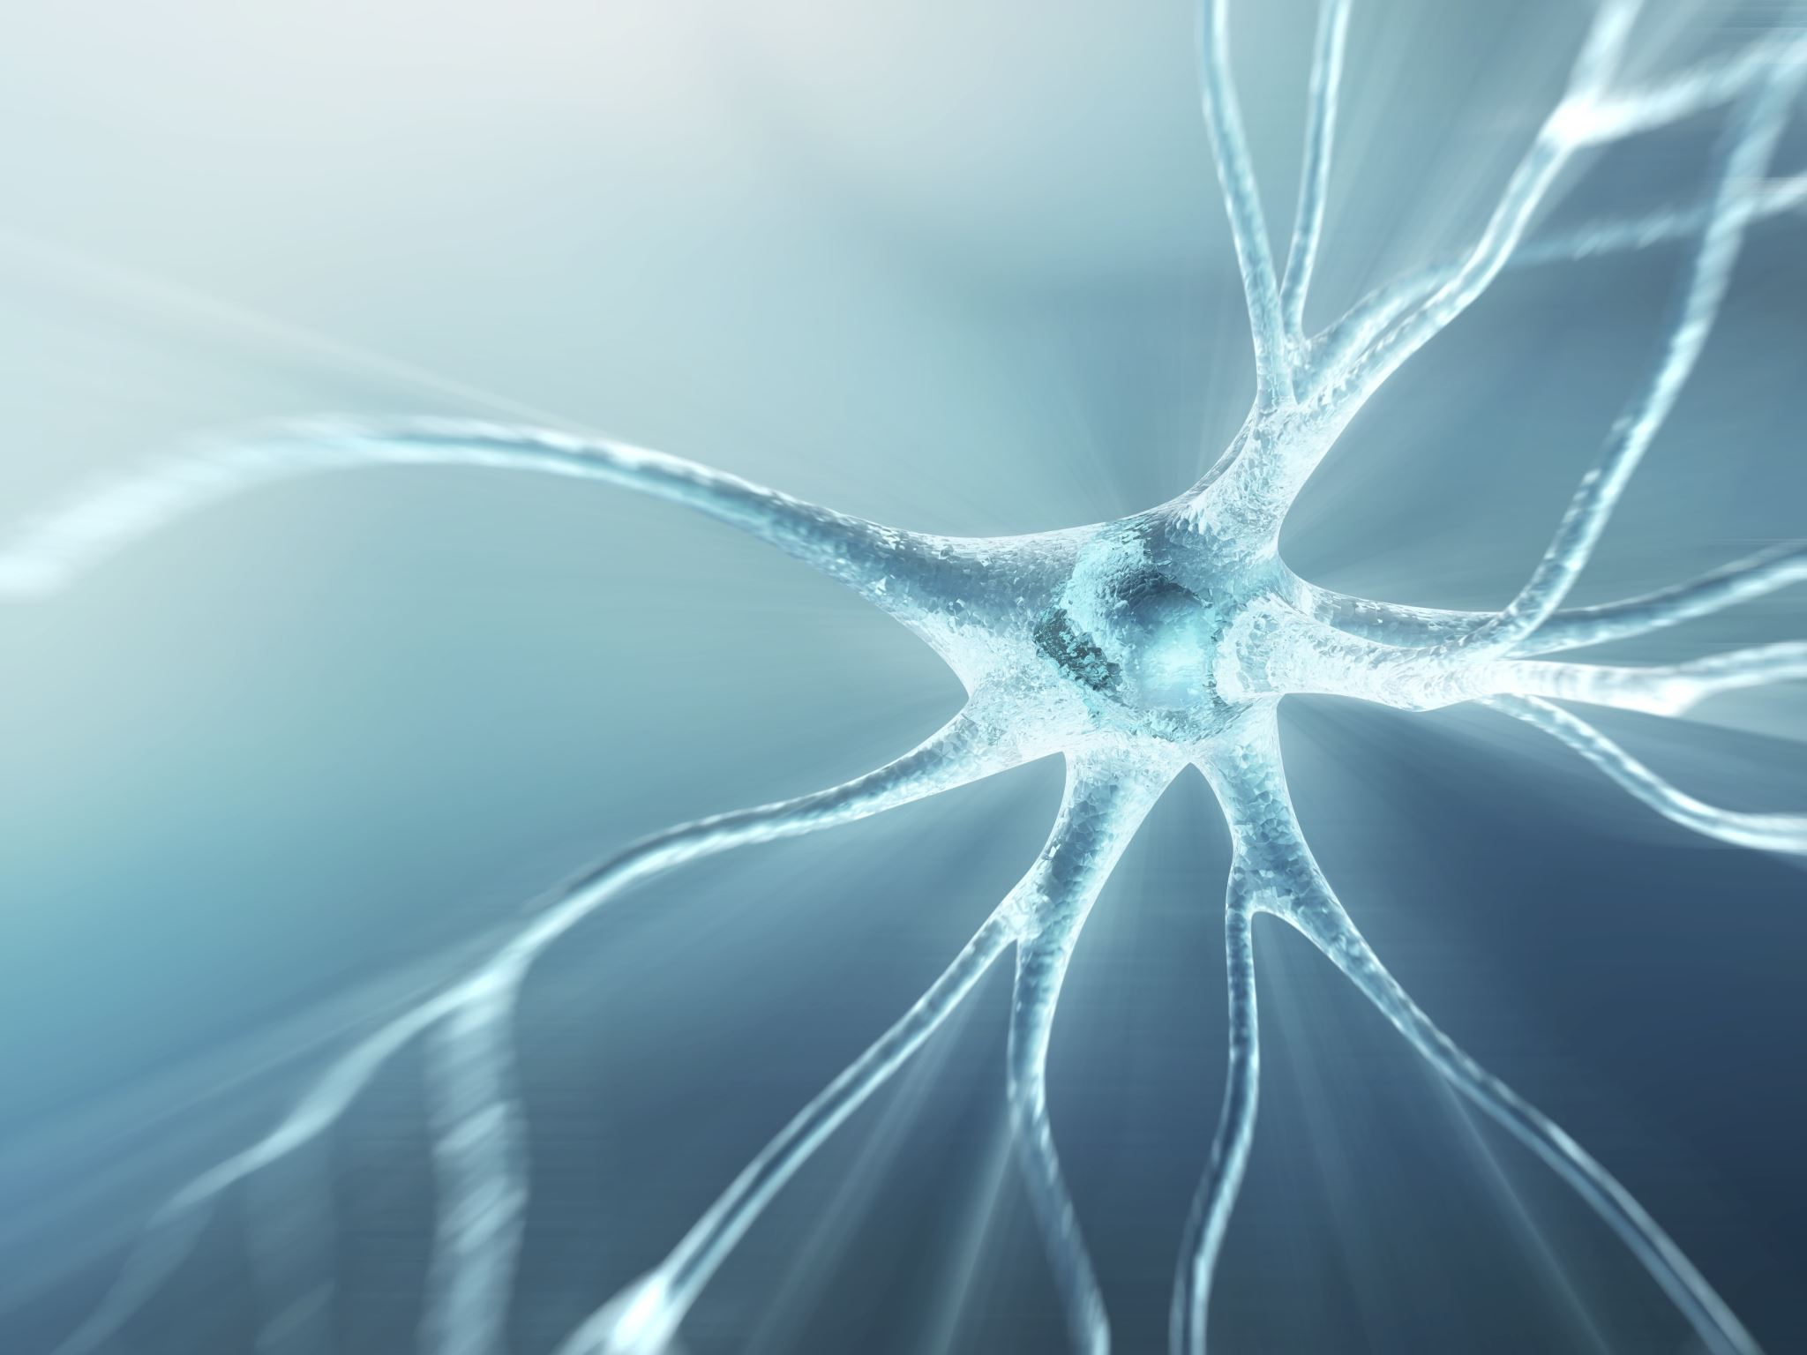
基于局部敏感Hash的高维检索
Yongcai Wang
Renmin University of China

Slide 2

主要内容
Locality Sensitive Hashing
A Full Example of LSH for ANN
LSH functions
LSH for ANN, Big Picture
Shingling
MinHash
LSH for document search
LSH for ANN, Analysis
Modern LSH
More on LSH
Deep LSH

Slide 3
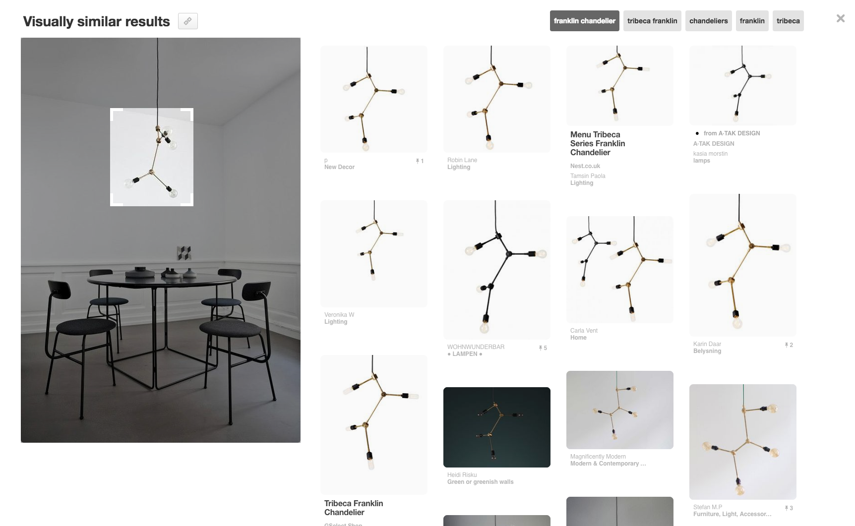
Pinterest Visual Search
Given a query image patch, find similar images
l=3
K=3
Notes:
… and find visually similar products and recommendations, in real-time
in this particular product, launched last November, you have a cropper tool which you can use to select portions of the image you’re interested in

Slide 4


How does it work?
…
Image Q Feature Vector
…
0
0
1
1
0
1
0
1
0
0
0
0
0
1
1
0
1
0
Hamming
Distance
Similarity (Q, B)
…
Image B Feature Vector
…
1
0
1
0
0
0
0
1
0
1
1
1
0
0
1
0
0
0
Collect billions of images
Determine feature vector for each image (4k dim)
Given a query Q, find nearest neighbors FAST
Notes:
So this is a great, semantically similar items clustering together is a good jump point for visual similarity. Say we have Image A and B, and we’d like to determine a similarity score for the two of them.
We start by running Image A through our network [BUILD] and extracting its intermediate representation, which gives us a feature vector [BUILD].
We can do the same thing for Image B [BUILD], giving us another feature vector. Now, computing image similarity is as simple as taking the Hamming distance [BUILD] between these two feature vectors, where a smaller distance means two images are more similar.

Slide 5
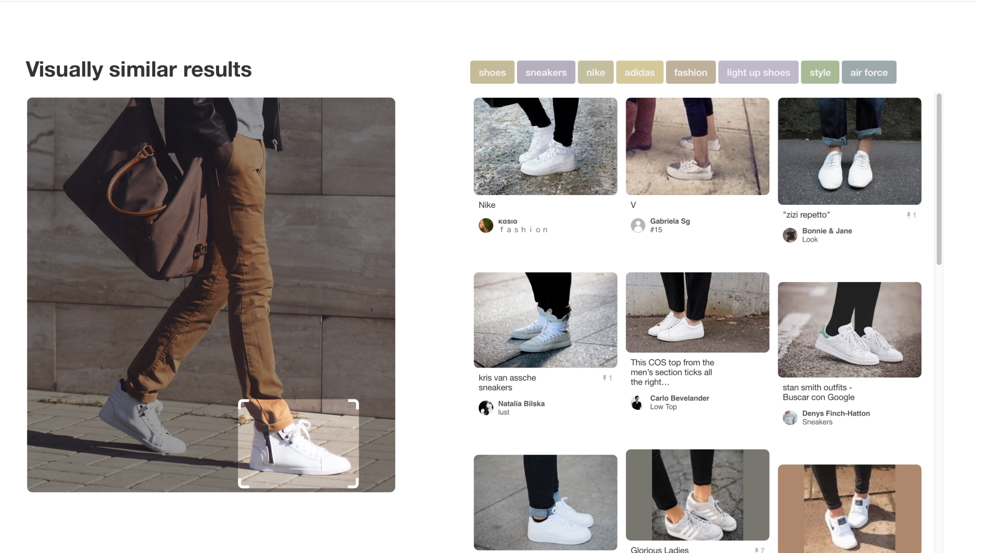
Application: Visual Search
Notes:
Then, after aggregating the labels into a heat map, we can use this as additional training data for our detector models

Slide 6
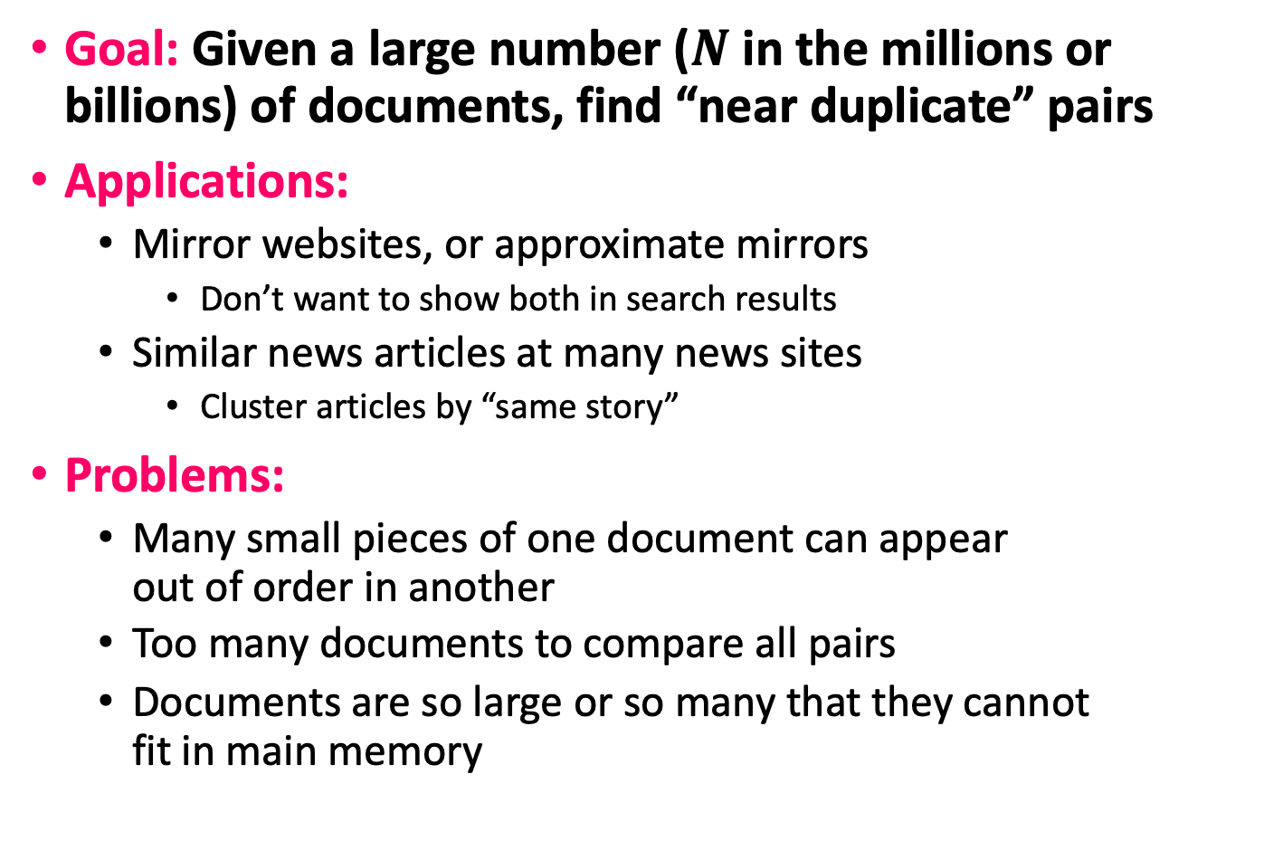
Task: Finding Similar Documents
Goal: Given a large number ($N$ in the millions or billions) of documents, find “near duplicate” pairs
Applications:
Mirror websites, or approximate mirrors
Don’t want to show both in search results
Similar news articles at many news sites
Cluster articles by “same story”
Problems:
Many small pieces of one document can appear out of order in another
Too many documents to compare all pairs
Documents are so large or so many that they cannot fit in main memory

Slide 7
3 Essential Steps for Similar Docs
Shingling: Convert documents to sets
Min-Hashing: Convert large sets to short signatures, while preserving similarity
Locality-Sensitive Hashing: Focus on pairs of signatures likely to be from similar documents
Candidate pairs!

Slide 8
The Big Picture
Candidate
pairs:
those pairs
of signatures
that we need
to test for
similarity
Shingling
Min Hashing
Locality-
Sensitive
Hashing
Docu-
ment
The set
of strings
of length k
that appear
in the doc-
ument
Signatures:
short integer
vectors that
represent the
sets, and
reflect their
similarity

Slide 9
Shingling
Shingling
Docu-
ment
The set
of strings
of length k
that appear
in the doc-
ument
Step 1: Shingling: Convert documents to sets

Slide 10
Documents as High-Dim Data
Step 1: Shingling: Convert documents to sets
Simple approaches:
Document = set of words appearing in document
Document = set of “important” words
Don’t work well for this application. Why?
Need to account for ordering of words!
A different way: Shingles!

Slide 11
Define: Shingles
A k-shingle (or k-gram) for a document is a sequence of k tokens that appears in the doc
Tokens can be characters, words or something else, depending on the application
Assume tokens = characters for examples
Example: k=2; document D₁ = abcab Set of 2-shingles: S(D₁) = {ab, bc, ca}
Option: Shingles as a bag (multiset), count ab twice: S’(D₁) = {ab, bc, ca, ab}

Slide 12
Compressing Shingles
To compress long shingles, we can hash them to (say) 4 bytes
Example: k=2; document D₁= abcab Set of 2-shingles: S(D₁) = {ab, bc, ca} Hash the singles: h(D₁) = {1, 5, 7}
Represent a document by the set of hash values of its k-shingles
Idea: Two documents could (rarely) appear to have shingles in common, when in fact only the hash-values were shared

Slide 13
Similarity Metric for Shingles
Document D₁ is a set of its k-shingles C₁=S(D₁)
Equivalently, encode each document by a 0/1 vector in the space of k-shingles
Each unique shingle is a dimension
Vectors are very sparse
A natural similarity measure is the Jaccard similarity:
sim(D₁, D₂) = |C₁∩C₂|/|C₁∪C₂|

Slide 14
Working Assumption
Documents that have lots of shingles in common have similar text, even if the text appears in different order
Caveat: You must pick k large enough, or most documents will have most shingles
k = 5 is OK for short documents
k = 10 is better for long documents

Slide 15
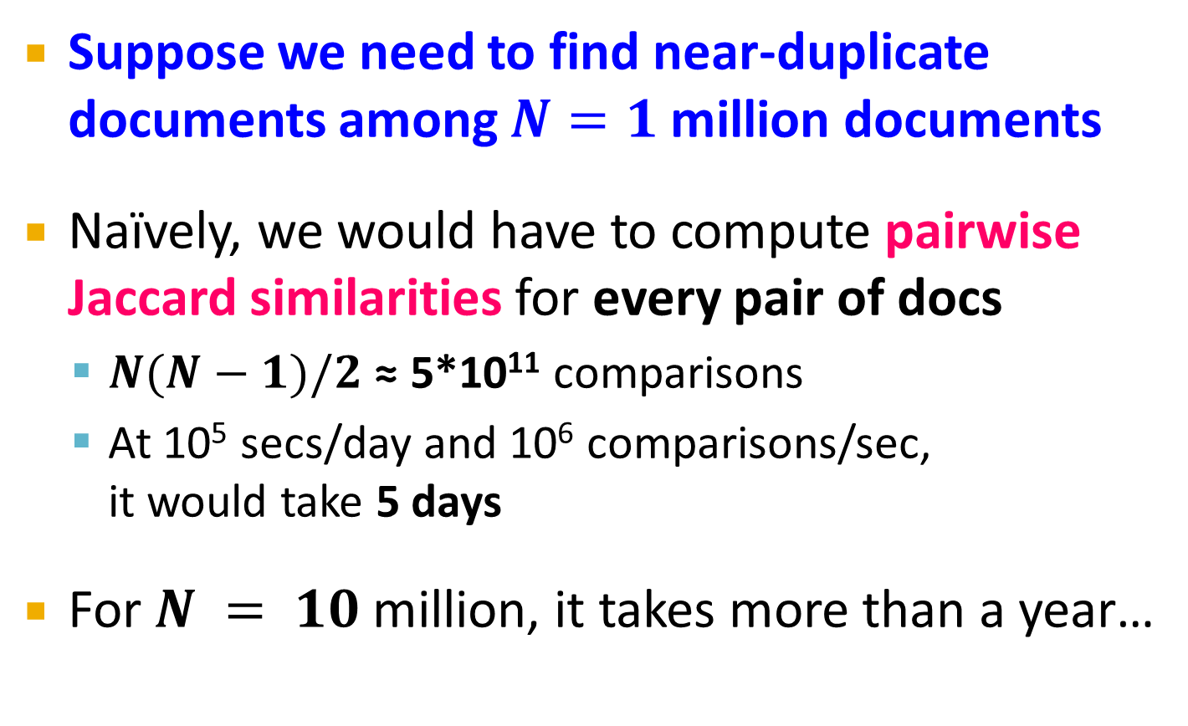
Motivation for Minhash/LSH
Suppose we need to find near-duplicate documents among $N=1$ million documents
Naïvely, we would have to compute pairwise Jaccard similarities for every pair of docs
$N(N−1)/2$ ≈ 5*10¹¹ comparisons
At 10⁵ secs/day and 10⁶ comparisons/sec, it would take 5 days
For $N = 10$ million, it takes more than a year…

Slide 16
MinHashing
Shingling
Min-Hash-
ing
Docu-
ment
The set
of strings
of length k
that appear
in the doc-
ument
Signatures:
short integer
vectors that
represent the
sets, and
reflect their
similarity
Step 2: Minhashing: Convert large sets to short signatures, while preserving similarity

Slide 17
Encoding Sets as Bit Vectors
Many similarity problems can be formalized as finding subsets that have significant intersection
Encode sets using 0/1 (bit, boolean) vectors
One dimension per element in the universal set
Interpret set intersection as bitwise AND, and set union as bitwise OR
Example: C₁ = 10111; C₂ = 10011
Size of intersection = 3; size of union = 4,
Jaccard similarity (not distance) = 3/4
Distance: d(C₁,C₂) = 1 – (Jaccard similarity) = 1/4

Slide 18
From Sets to Boolean Matrices
Rows = elements (shingles)
Columns = sets (documents)
1 in row e and column s if and only if e is a member of s
Column similarity is the Jaccard similarity of the corresponding sets (rows with value 1)
Typical matrix is sparse!
Each document is a column:
Example: sim(C₁ ,C₂) = ?
Size of intersection = 3; size of union = 6, Jaccard similarity (not distance) = 3/6
d(C₁,C₂) = 1 – (Jaccard similarity) = 3/6
Documents
1
1
1
0
1
1
0
1
0
1
0
1
0
0
0
1
Shingles
1
0
0
1
1
1
1
0
1
0
1
0

Slide 19
Outline: Finding Similar Columns
So far:
Documents → Sets of shingles
Represent sets as boolean vectors in a matrix
Next goal: Find similar columns while computing small signatures
Similarity of columns == similarity of signatures

Slide 20
Outline: Finding Similar Columns
Next Goal: Find similar columns, Small signatures
Naïve approach:
1) Signatures of columns: small summaries of columns
2) Examine pairs of signatures to find similar columns
Essential: Similarities of signatures and columns are related
3) Optional: Check that columns with similar signatures are really similar
Warnings:
Comparing all pairs may take too much time
These methods can produce false negatives, and even false positives (if the optional check is not made)

Slide 21
Hashing Columns (Signatures)
Key idea: “hash” each column C to a small signature h(C), such that:
(1) h(C) is small enough that the signature fits in RAM
(2) sim(C₁, C₂) is the same as the “similarity” of signatures h(C₁) and h(C₂)
Goal: Find a hash function h(·) such that:
If sim(C₁,C₂) is high, then with high prob. h(C₁) = h(C₂)
If sim(C₁,C₂) is low, then with high prob. h(C₁) ≠ h(C₂)
Hash docs into buckets. Expect that “most” pairs of near duplicate docs hash into the same bucket!

Slide 22
Min-Hashing
Goal: Find a hash function h(·) such that:
if sim(C₁,C₂) is high, then with high prob. h(C₁) = h(C₂)
if sim(C₁,C₂) is low, then with high prob. h(C₁) ≠ h(C₂)
Clearly, the hash function depends on the similarity metric:
Not all similarity metrics have a suitable hash function
There is a suitable hash function for the Jaccard similarity: It is called Min-Hashing

Slide 23
Min-Hashing
Imagine the rows of the boolean matrix permuted under random permutation π
Define a “hash” function h_{π}(C) = the index of the first (in the permuted order π) row in which column C has value 1:
h_{π} (C) = min_{π} π(C)
Use several (e.g., 100) independent hash functions (that is, permutations) to create a signature of a column

Slide 24
Min-Hashing Example
2nd element of the permutation is the first to map to a 1
Permutation π
Input matrix (Shingles x Documents)
Signature matrix M
2
4
3
4
7
2
6
1
5
1
0
1
0
2
1
2
1
3
2
1
0
0
1
2
1
4
1
7
1
0
1
0
1
1
2
1
2
6
3
0
1
0
1
1
6
0
1
0
1
4th element of the permutation is the first to map to a 1
5
7
1
0
1
0
4
5
1
0
1
0

Slide 25
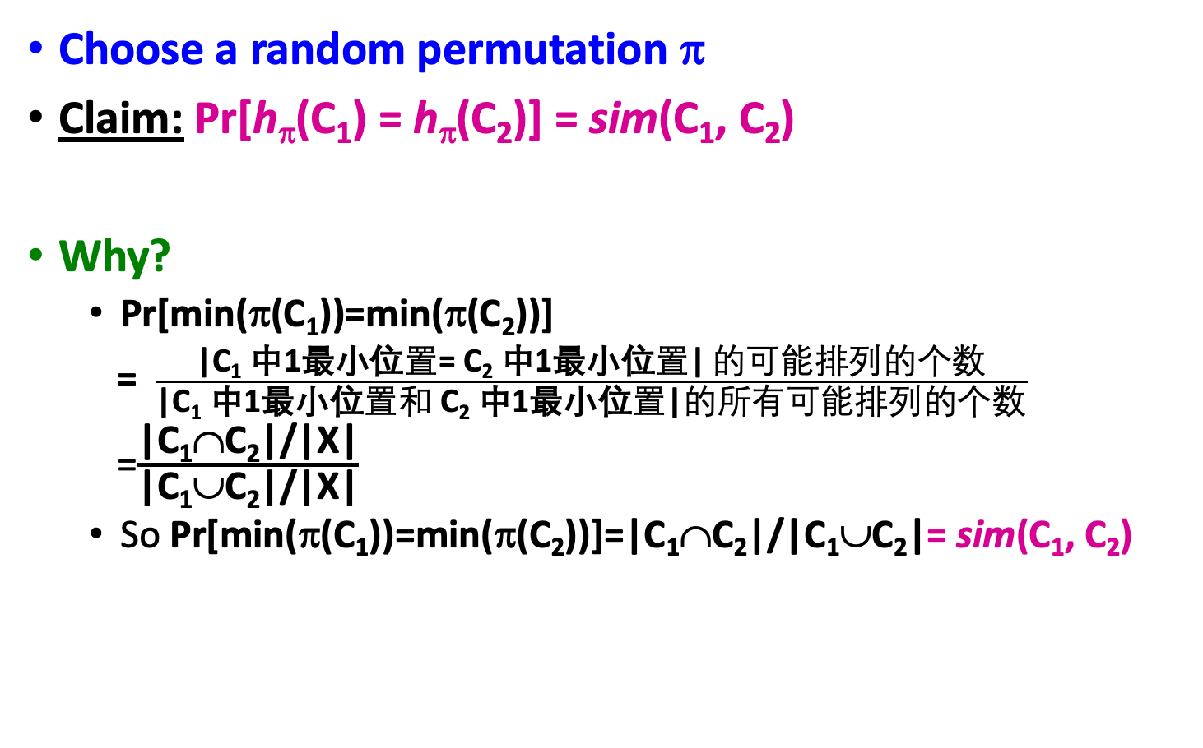
The Min-Hash Property
0
0
0
0
1
1
Choose a random permutation π
Claim: Pr[h_{π}(C₁) = h_{π}(C₂)] = sim(C₁, C₂)
Why?
Pr[min(π(C₁))=min(π(C₂))]
= $\frac{\text{|}\text{C}\text{1} \text{中}\text{1}\text{最小位}置\text{= }\text{C}\text{2} \text{中}\text{1}\text{最小位}置\text{|} 的可能排列的个数}{\text{|}\text{C}\text{1} \text{中}\text{1}\text{最小位}置和 \text{C}\text{2} \text{中}\text{1}\text{最小位}置\text{|}的所有可能排列的个数}$
=$\frac{\text{|}\text{C}\text{1}\text{∩}\text{C}\text{2}\text{|}\text{/}\text{|}\text{X}\text{|}}{\text{|}\text{C}\text{1}\text{∪}\text{C}\text{2}\text{|/|}\text{X}\text{|}}$
So Pr[min(π(C₁))=min(π(C₂))]=|C₁∩C₂|/|C₁∪C₂|= sim(C₁, C₂)
0
0
0
1
1
0
Notes:
Size of the universe of all possible vals of min(π(C₁∪C₂)) is |C₁∪C₂| and in |C₁∩C₂| of cases it can be that min(π(C₁))=min(π(C₂)) which exactly the jaccard between C1 and C2
For two columns A and B, we have h_π(A) = h_π(B) exactly when the minimum hash value of the union A ∪ B lies in the intersection A ∩ B. Thus Pr[h_π(A) = h_π(B)] = |A ∩ B| / |A ∪ B|.

Slide 26
Four Types of Rows
Given cols C₁ and C₂, rows may be classified as:
C₁ C₂
A 1 1
B 1 0
C 0 1
D 0 0
a = # rows of type A, etc.
Note: sim(C₁, C₂) = a/(a +b +c)
Then: Pr[h(C₁) = h(C₂)] = Sim(C₁, C₂)
Look down the cols C₁ and C₂ until we see a 1
If it’s a type-A row, then h(C₁) = h(C₂) If a type-B or type-C row, then not

Slide 27
Similarity for Signatures
We know: Pr[h_{π}(C₁) = h_{π}(C₂)] = sim(C₁, C₂)
Now generalize to multiple hash functions
The similarity of two signatures is the fraction of the hash functions in which they agree
Note: Because of the Min-Hash property, the similarity of columns is the same as the expected similarity of their signatures
Notes:
Each agress with prob s.
So to estimate s we compute what fraction of hash functions agree

Slide 28
Min-Hashing Example
Permutation π
Input matrix (Shingles x Documents)
Signature matrix M
2
4
3
4
7
2
6
1
5
1
0
1
0
2
1
2
1
3
2
1
0
0
1
2
1
4
1
7
1
0
1
0
1
1
2
1
2
6
3
0
1
0
1
特征向量的对比问题
1
6
0
1
0
1
Similarities:
1-3 2-4 1-2 3-4
Col/Col 0.75 0.75 0 0
Sig/Sig 0.67 1.00 0 0
5
7
1
0
1
0
4
5
1
0
1
0
列编码的对比问题

Slide 29
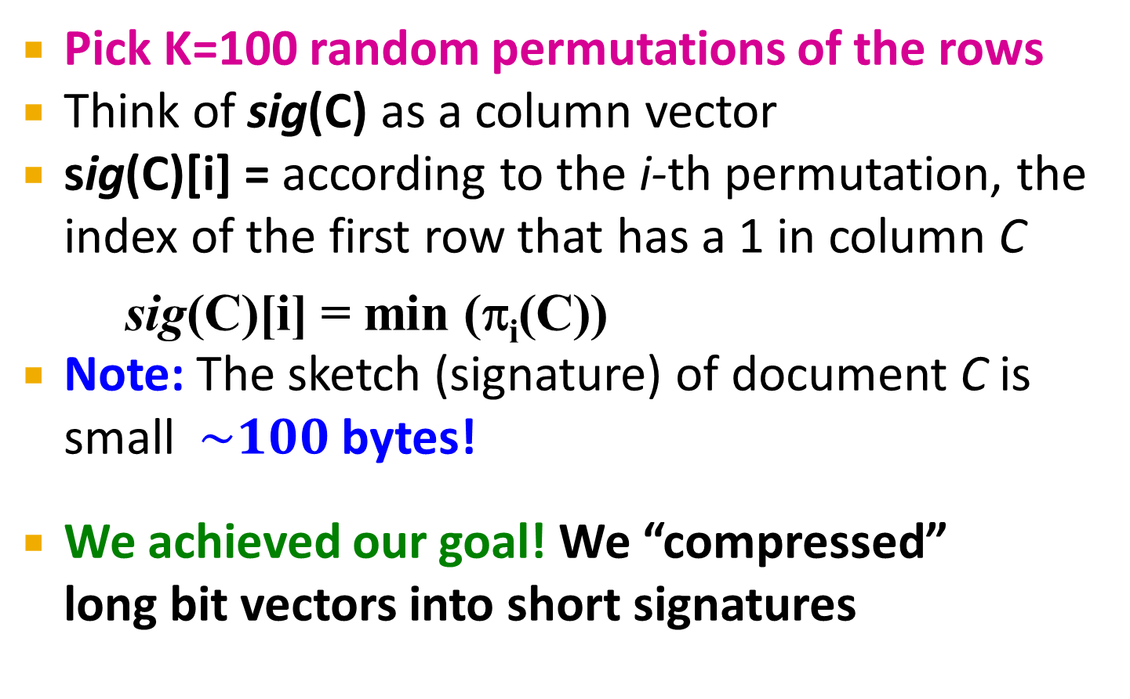
Min-Hash Signatures
Pick K=100 random permutations of the rows
Think of sig(C) as a column vector
sig(C)[i] = according to the i-th permutation, the index of the first row that has a 1 in column C
sig(C)[i] = min (π_{i}(C))
Note: The sketch (signature) of document C is small $\sim 100$ bytes!
We achieved our goal! We “compressed” long bit vectors into short signatures

Slide 30
Min-Hash Signatures
Let sim’(C₁, C₂) = (# of sig(C₁)[i] = sig(C₂)[i])/K
We know E[sim’(C₁, C₂) ] = sim(C₁, C₂)
If we want
Pr[|sim’(C₁, C₂) -sim(C₁, C₂)|<ε]>1-δ
For example, ε=0.01, δ=0.001
How large should we set K?
For any constant ε > 0 there is a constant k = O(1/ε²) such that the expected error of the estimate is at most ε. From WiKi
For example ε =0.1, k = 100, such that the expected error of the estimate is at most ε. From WiKi
https://en.wikipedia.org/wiki/MinHash

Slide 31
Implementation Trick
Permuting rows even once is prohibitive
Row hashing!
Pick K = 100 hash functions k_{i}
Ordering under k_{i} gives a random row permutation!
One-pass implementation
For each column C and hash-func. k_{i} keep a “slot” for the min-hash value
Initialize all sig(C)[i] = ∞
Scan rows looking for 1s
Suppose row j has 1 in column C
Then for each k_{i} :
If k_{i}(j) < sig(C)[i], then sig(C)[i] ← k_{i}(j)
How to pick a random hash function h(x)?
Universal hashing:
h_{a,b}(x)=((a·x+b) mod p) mod N
where:
a,b … random integers
p … prime number (p > N)

Slide 32
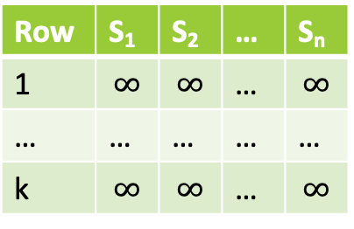
One-pass implementation of MinHash
Given document code matrix
Given k hash function h₁(),…, h_{k}()
Initialize signature table S[i][j] = ∞
Row | C₁ | C₂ | … | C_{n}
1 | 1 | 0 | … | 0
2 | 0 | 1 | … | 0
… | … | … | … | …
m | 0 | 1 | … | 1
具体算法：
k次全表更新
for r=1:1:m
h[1:k] = {h₁(r), h₂(r),…, h_{k}(r)}
for c =1:1:n
if (C[r][c] == 0)
continue;
else
for i =1:1:k
if S[i][c] > h[i]
S[i][c] = h[i]
return S
C
列遍历
行遍历
Row | S₁ | S₂ | … | S_{n}
1 | $$∞$$ | $$∞$$ | … | $$∞$$
… | … | … | … | …
k | $$∞$$ | $$∞$$ | … | $$∞$$
S
时间复杂度 O(mnk)

Slide 33
举例
选用两个hash函数
C
S
初始化的S
r=1
r=2
r=3
r=4
r=5
具体参考《Mining of Massive Data》这本书的3.3.5， 3.3.6这两节

Slide 34
Locality Sensitive Hashing
Candidate
pairs:
those pairs
of signatures
that we need
to test for
similarity
Shingling
Min-Hash-
ing
Locality-
Sensitive
Hashing
Docu-
ment
The set
of strings
of length k
that appear
in the doc-
ument
Signatures:
short integer
vectors that
represent the
sets, and
reflect their
similarity
Step 3: Locality-Sensitive Hashing: Focus on pairs of signatures likely to be from similar documents

Slide 35
LSH: First Cut
2
1
4
1
1
2
1
2
2
1
2
1
Goal: Find documents with Jaccard similarity at least s (for some similarity threshold, e.g., s=0.8)
LSH – General idea: Use a function f(x,y) that tells whether x and y is a candidate pair: a pair of elements whose similarity must be evaluated
For Min-Hash matrices:
Hash columns of signature matrix M to many buckets
Each pair of documents that hashes into the same bucket is a candidate pair

Slide 36
Candidates from Min-Hash
2
1
4
1
1
2
1
2
2
1
2
1
Pick a similarity threshold s (0 < s < 1)
Columns x and y of M are a candidate pair if their signatures agree on at least fraction s of their rows: M (i, x) = M (i, y) for at least frac. s values of i
We expect documents x and y to have the same (Jaccard) similarity as their signatures

Slide 37
LSH for Min-Hash
2
1
4
1
1
2
1
2
2
1
2
1
Big idea: Hash columns of signature matrix M several times
Arrange that (only) similar columns are likely to hash to the same bucket, with high probability
Candidate pairs are those that hash to the same bucket

Slide 38
Partition M into b Bands
2
1
4
1
1
2
1
2
2
1
2
1
r rows
per band
b bands
One
signature
Signature matrix M

Slide 39
Partition M into Bands
Divide matrix M into b bands of r rows
For each band, hash its portion of each column to a hash table with k buckets
Make k as large as possible
Candidate column pairs are those that hash to the same bucket for ≥ 1 band
Tune b and r to catch most similar pairs, but few non-similar pairs

Slide 40
Hashing Bands
Buckets
Columns 2 and 6
are probably identical
(candidate pair)
Columns 6 and 7 are
surely different.
Matrix M
r rows
b bands

Slide 41
Example of Bands
2
1
4
1
1
2
1
2
2
1
2
1
Assume the following case:
Suppose 100,000 columns of M (100k docs)
Signatures of 100 integers (rows)
Therefore, signatures take 40Mb
Choose b = 20 bands of r = 5 integers/band
Goal: Find pairs of documents that are at least s = 0.8 similar

Slide 42
C₁, C₂ are 80% Similar
Find pairs of ≥ s=0.8 similarity, set b=20, r=5
Assume: sim(C₁, C₂) = 0.8
Since sim(C₁, C₂) ≥ s, we want C₁, C₂ to be a candidate pair: We want them to hash to at least 1 common bucket (at least one band is identical)
Probability C₁, C₂ identical in one particular band: (0.8)⁵ = 0.328
Probability C₁, C₂ are not similar in all of the 20 bands: (1-0.328)²⁰ = 0.00035
i.e., about 1/3000th of the 80%-similar column pairs are false negatives (we miss them)
We would find 99.965% pairs of truly similar documents

Slide 43
C₁, C₂ are 30% Similar
2
1
4
1
1
2
1
2
2
1
2
1
Find pairs of ≥ s=0.8 similarity, set b=20, r=5
Assume: sim(C₁, C₂) = 0.3
Since sim(C₁, C₂) < s we want C₁, C₂ to hash to NO common buckets (all bands should be different)
Probability C₁, C₂ identical in one particular band: (0.3)⁵ = 0.00243
Probability C₁, C₂ identical in at least 1 of 20 bands: 1 - (1 - 0.00243)²⁰ = 0.0474
In other words, approximately 4.74% pairs of docs with similarity 0.3% end up becoming candidate pairs
They are false positives since we will have to examine them (they are candidate pairs) but then it will turn out their similarity is below threshold s

Slide 44
LSH Involves a Tradeoff
2
1
4
1
1
2
1
2
2
1
2
1
Pick:
The number of Min-Hashes (rows of M)
The number of bands b, and
The number of rows r per band
to balance false positives/negatives
Example: If we had only 15 bands of 5 rows, the number of false positives would go down, but the number of false negatives would go up

Slide 45
Analysis of LSH – What We Want
Probability = 1 if t > s
Probability
of sharing
a bucket
No chance
if t < s
Similarity threshold s
Similarity t =sim(C₁, C₂) of two sets

Slide 46
What 1 Band of 1 Row Gives You
Probability
of sharing
a bucket
Remember:
Probability of
equal hash-values
= similarity
Similarity t =sim(C₁, C₂) of two sets

Slide 47
The S-Curve
The S-curve is where the “magic” happens
Remember:
Probability of
equal hash-values
= similarity
Threshold s
Probability=1 if t>s
Probability of sharing ≥ 1 bucket
No chance
if t<s
Similarity t of two sets
Similarity t of two sets
This is what 1 hash-code gives you
Pr[h_{π}(C₁) = h_{π}(C₂)] = sim(D₁, D₂)
This is what we want!
How to get a step-function?
By choosing r and b!

Slide 48
b bands, r rows/band
Columns C₁ and C₂ have similarity t
Pick any band (r rows)
Prob. that all rows in band equal = t^{r}
Prob. that some row in band unequal = 1 - t^{r}
Prob. that no band identical = (1 - t^{r})^{b}
Prob. that at least 1 band identical = 1 - (1 - t^{r})^{b}

Slide 49
What b Bands of r Rows Gives You
No bands
identical
At least
one band
identical
(
)^{b}
Probability
of sharing
a bucket
s ~ (1/b)^{1/r}
1 -
1 -
t ^{r}
All rows
of a band
are equal
Some row
of a band
unequal
Similarity t=sim(C₁, C₂) of two sets

Slide 50
Example: b = 20; r = 5
Similarity threshold s
Prob. that at least 1 band is identical:
s | 1-(1-s^{r})^{b}
.2 | .006
.3 | .047
.4 | .186
.5 | .470
.6 | .802
.7 | .975
.8 | .9996

Slide 51
蓝色的区域和绿色的区域分别代表什么？当MinHash signature的长度固定式，变化b和r会使得这两个区域如何变化？
Prob. sharing a bucket
Similarity

Slide 52
Picking r and b: The S-curve
Picking r and b to get the best S-curve
50 hash-functions (r=5, b=10)
Prob. sharing a bucket
Green area: False Negative rate
Blue area: False Positive rate
Similarity

Slide 53
S-curves as a func. of b and r
r = 1..10, b = 1
r = 5, b = 1..50
Given a fixed threshold s.
We want choose r and b such that the P(Candidate pair) has a “step” right around s.
Prob(Candidate pair)
r = 10, b = 1..50
Prob(Candidate pair)
r = 1, b = 1..10
Similarity
Similarity
prob = 1 - (1 - t ^{r})^{b}

Slide 54
回顾这个过程：
Shingling
Min-Hashing
Locality Sensitive Hashing
这里描述了几个哈希函数？分别起什么作用？

Slide 55
LSH Summary
Tune M, b, r to get almost all pairs with similar signatures, but eliminate most pairs that do not have similar signatures
Check in main memory that candidate pairs really do have similar signatures
Optional: In another pass through data, check that the remaining candidate pairs really represent similar documents

Slide 56
Summary: 3 Steps
Shingling: Convert documents to sets
We used hashing to assign each shingle an ID
Min-Hashing: Convert large sets to short signatures, while preserving similarity
We used similarity preserving hashing to generate signatures with property Pr[h_{π}(C₁) = h_{π}(C₂)] = sim(C₁, C₂)
We used hashing to get around generating random permutations
Locality-Sensitive Hashing: Focus on pairs of signatures likely to be from similar documents
We used hashing to find candidate pairs of similarity ≥ s

Slide 57
Hashing Query Point
Buckets
Columns 2 and 6
are candidate points
Matrix M
Query point
r rows
b bands

Slide 58
Recap: LSH for ANN
Suppose we are given a hash family H that is (r, c, p1, p2)-LSH. Our goal is to use it as a subroutine to design an algorithm for the NN(q,r,c) problem.
Let G be set of k hash function.
Choose g₁,g₂,...,g_{l} i.i.d. from G. for each i = 1,2,...,l, store x ∈ D into the bucket g_{i}(x) = ⟨h_{i1}(x),h_{i2}(x),...,h_{ik}(x)⟩.
Given query q, compute g₁(q),g₂(q),...,g_{l}(q).
Consider these buckets in order, and for each x ∈ D in these buckets, compute the distance from x to q.
If any of these is at most c × r, report this item and stop.
Otherwise continue till 4l checked iterms and report failure.
Algorithm design and analysis, Yongcai Wang

Slide 59
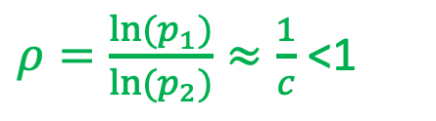
Recap
So the total running time and space usage of LSH comparing with K-D Tree
$ρ=\frac{ln⁡(p_{1})}{ln⁡(p_{2})}≈\frac{1}{c}$ <1
So LSH based multiple dimension search is theoretically much faster than K-D tree and the space used is not too much.

Slide 60

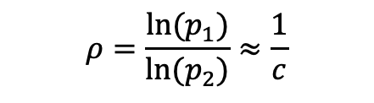
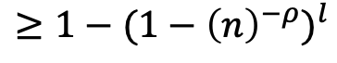
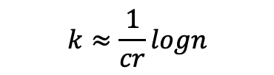
Recap
在如下参数选择情况下：
$$ρ=\frac{ln⁡(p_{1})}{ln⁡(p_{2})}≈\frac{1}{c}$$
$$l≈n^{\frac{1}{c}}$$
$$k≈\frac{1}{cr}logn$$
成功冲突的概率：
Pr[x* and q collide at least once in l tables]:
$$≥1−{(1−{\left(n\right)}^{−ρ})}^{l}$$

Slide 61
主要内容
Locality Sensitive Hashing
A Full Example of LSH for ANN
LSH functions
LSH for ANN, Big Picture
Shingling
MinHash
LSH for document search
LSH for ANN, Analysis
Modern LSH
More on LSH
Deep LSH

Slide 62
More on LSH
Original LSH algorithm (1999): previous version of the algorithm for the Hamming distance is described in [GIM'99] paper.
Locality-Sensitive Hashing Scheme Based on p-Stable Distributions (by Alexandr Andoni, Mayur Datar, Nicole Immorlica, Piotr Indyk, and Vahab Mirrokni), appearing in the book Nearest Neighbor Methods in Learning and Vision: Theory and Practice, by T. Darrell and P. Indyk and G. Shakhnarovich (eds.), MIT Press, 2006.
Not-so-recent algorithm for Euclidean space (2006): "Near-Optimal Hashing Algorithms for Near Neighbor Problem in High Dimensions" (by Alexandr Andoni and Piotr Indyk). In FOCS'06.

Slide 63
More on LSH
Survey of LSH in CACM (2008): "Near-Optimal Hashing Algorithms for Approximate Nearest Neighbor in High Dimensions" (by Alexandr Andoni and Piotr Indyk). Communications of the ACM, vol. 51, no. 1, 2008, pp. 117-122. (CACM disclaimer). also available directly from CACM (for free).
Beyond Locality Sensitive Hashing (by Alexandr Andoni, Piotr Indyk, Huy L. Nguyen, and Ilya Razenshteyn). In SODA'14.
Optimal Data-Dependent Hashing for Approximate Near Neighbors (by Alexandr Andoni and Ilya Razenshteyn). In STOC'15. Full version in arXiv:1501.01062.

Slide 64
More on LSH
Practical and Optimal LSH for Angular Distance (with Piotr Indyk, Thijs Laarhoven, Ilya Razenshteyn and Ludwig Schmidt). In NIPS'15.
2015--2016 FALCONN package, which is a package based on newer ideas (namely the NIPS'15 paper above).
Application of Locality Sensitive Hashing to Realtime Loop Closure Detection 基于LSH的基于图像SLAM的闭环检测方法
Hashing with Graphs, ICML 2011

Slide 65
LSH vs. BoW in loop closure detection

Slide 66
Hashing with Graphs: Anchor Graph Hashing

Slide 67
Hashing with Graphs: Anchor Graph Hashing

Slide 68
Learning based LSH
Learning to Hash with Binary Reconstructive Embeddings , NIPS 2009
DQN: Deep Quantization Network for Efficient Image Retrieval, Yue Cao, Mingsheng Long, Jianmin Wang, Han Zhu, Qingfu Wen, AAAI Conference on Artificial Intelligence (AAAI), 2016
DHN: Deep Hashing Network for Efficient Similarity Retrieval, Han Zhu, Mingsheng Long, Jianmin Wang, Yue Cao, AAAI Conference on Artificial Intelligence (AAAI), 2016
DVSQ: Deep Visual-Semantic Quantization for Efficient Image Retrieval, Yue Cao, Mingsheng Long, Jianmin Wang, Shichen Liu, IEEE Conference on Computer Vision and Pattern Recognition (CVPR), 2017
DCH: Deep Cauchy Hashing for Hamming Space Retrieval, Yue Cao, Mingsheng Long, Bin Liu, Jianmin Wang, IEEE Conference on Computer Vision and Pattern Recognition (CVPR), 2018
DTQ: Deep Triplet Quantization, Bin Liu, Yue Cao, Mingsheng Long, Jianmin Wang, Jingdong Wang, ACM Multimedia (ACMMM), 2018
DeepHash, github code
A Survey on Deep Hashing Methods , 2020

Slide 69
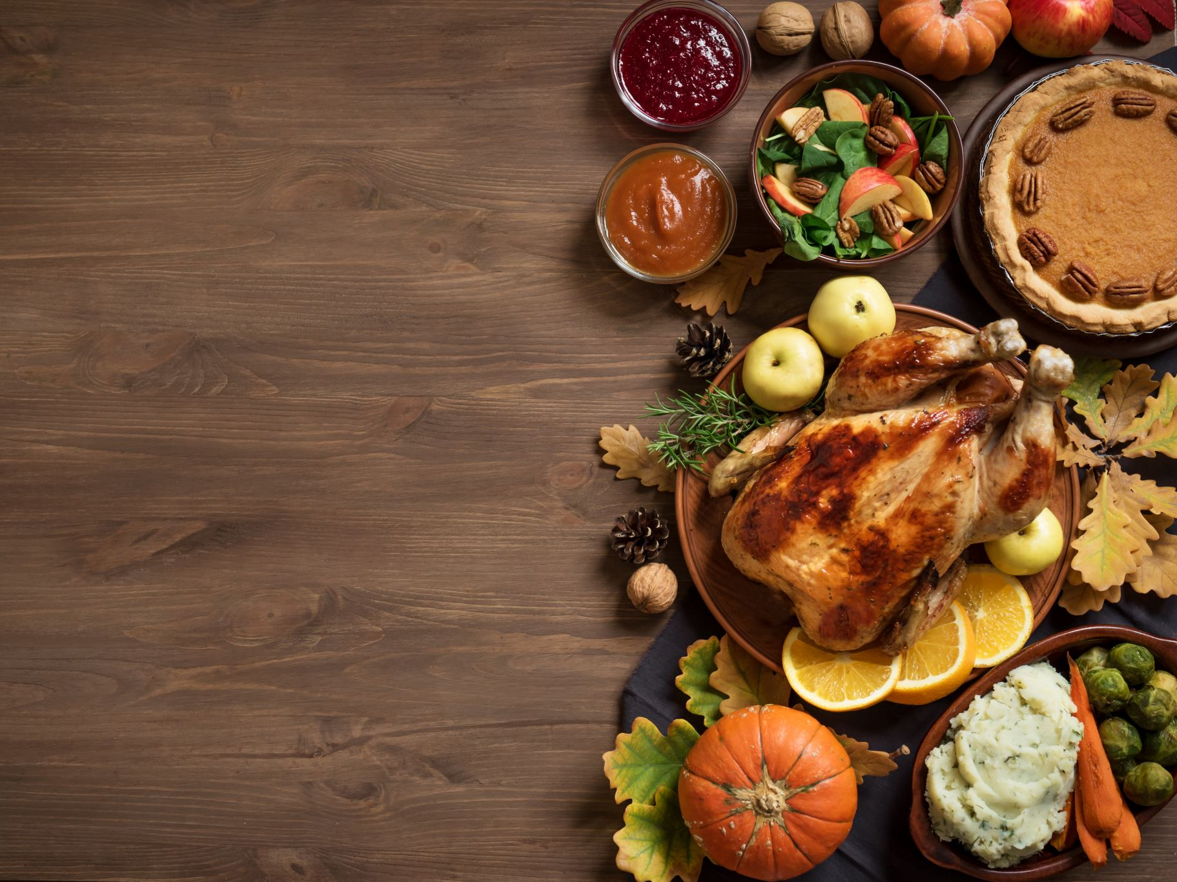
Thanks.
We turn to graphs in the next lecture.

